Slide 1
IMAGE CAPTIONING
CSE 676 Deep Learning: Group 13
Srikar Challa, 50312357, srikarch@buffalo.edu
Srisai Karthik Neelamraju, 50316785, neelamra@buffalo.edu
Anantha Srinath Sedimbi, 50315869, asedimbi@buffalo.edu
05-May-2020

Slide 2
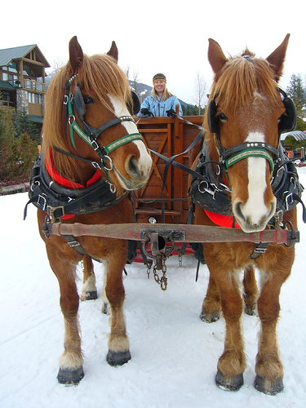
Introduction
Image captioning is automatically describing the contents of an image.
Can significantly help visually impaired people and has many applications like automatic image indexing
Aim: To implement a model that takes as input an image and outputs an accurate description of the image
Two key challenges
learning better features from an image, involves recognizing key objects, their attributes and their relationships in the image
Generating both syntactically and semantically correct sentences from the obtained features
Two horses pull a carriage driven by a woman over snow covered ground.
Image Captioning Model

Slide 3
Original Work
2015: Show and Tell by Vinyals, Oriol, et al.
Architecture: GoogLeNet (InceptionV1) + LSTM
2016: Show, Attend and Tell by Xu, Kelvin, et al.
Architecture: VGG16 + LSTM + Attention
Feature Extraction
Encoder
Decoder
Caption
Input Image

Slide 4
Scope for Improvement
Can be broadly classified into two areas
Feature Extraction
improve accuracy in object detection
reduce the number of model parameters
Caption Generation
improve syntax and semantics of the generated text
(use better language models)
Many sophisticated models for image captioning ^{[1]} have already established high-performance benchmarks.
Q: What can we improve with limited resources?
[1] Hossain, MD Zakir, et al. "A comprehensive survey of deep learning for image captioning." ACM Computing Surveys (CSUR) 51.6 (2019): 1-36.

Slide 5
Ideas Considered
Feature Extraction
change existing architectures or design a new CNN architecture
Problems:
training new models requires a lot of computational resources
existing models are quite superior, new model has no guarantee of better performance
employ different pre-trained models
Caption Generation (LSTM and GRU are typically used for this)
try a custom GRU/LSTM cell (introduce new gates, modify activation functions, etc.)
Problem: such changes require in depth conceptual knowledge and mathematical justification of improving the model performance
try a different text generation model – Transformer ^{[1]} / Sequence-to-sequence GAN ^{[2]}
[1] Vaswani, Ashish, et al. "Attention is all you need." Advances in neural information processing systems. 2017.
[2] Yu, Lantao, et al. "Seqgan: Sequence generative adversarial nets with policy gradient." Thirty-First AAAI Conference on Artificial Intelligence. 2017.

Slide 6
Improvement in Feature Extraction
Feature extraction is typically achieved using very deep CNN architectures.
The model in the original paper ^{[1]} used the VGG16 architecture.
network weights were pretrained on ImageNet
However, the network has very large number of parameters (~140M). This means difficulty in deploying the network and longer inference time.
Several other CNN network architectures are proven to be much superior to VGG16, in terms of reducing the computational cost as well as providing better performance.
Hence, we employ different pre-trained models instead of VGG16.
[1] Xu, Kelvin, et al. "Show, attend and tell: Neural image caption generation with visual attention." International conference on machine learning. 2015.

Slide 7
Improvement in Feature Extraction (Contd.)
The table ^{[1]} summarizes the performance of four deep CNN architectures on ImageNet.
Clearly, employing either InceptionV3 or Xception architecture greatly reduces the number of parameters.
We separately use InceptionV3 and Xception architectures instead of VGG16.
Model | Top-1 Accuracy | Top-5 Accuracy | Parameters | Depth | Weights Size
VGG16 | 0.713 | 0.901 | 138,357,544 | 23 | 528MB
VGG19 | 0.713 | 0.900 | 143,667,240 | 29 | 549MB
InceptionV3 | 0.779 | 0.937 | 23,851,784 | 159 | 92MB
Xception | 0.790 | 0.945 | 22,910,480 | 126 | 88MB
[1] https://keras.io/applications/

Slide 8
Improvement in Caption Generation
Caption generation is typically achieved using RNN architectures.
The model in the original paper ^{[1]} used LSTM-based sequence generator.
Our modifications:
Replaced the LSTM units with GRU + Attention layer
Replaced the RNN with Transformer (self-attention)
[1] Vinyals, Oriol, et al. "Show and tell: A neural image caption generator." Proceedings of the IEEE conference on computer vision and pattern recognition. 2015.

Slide 9
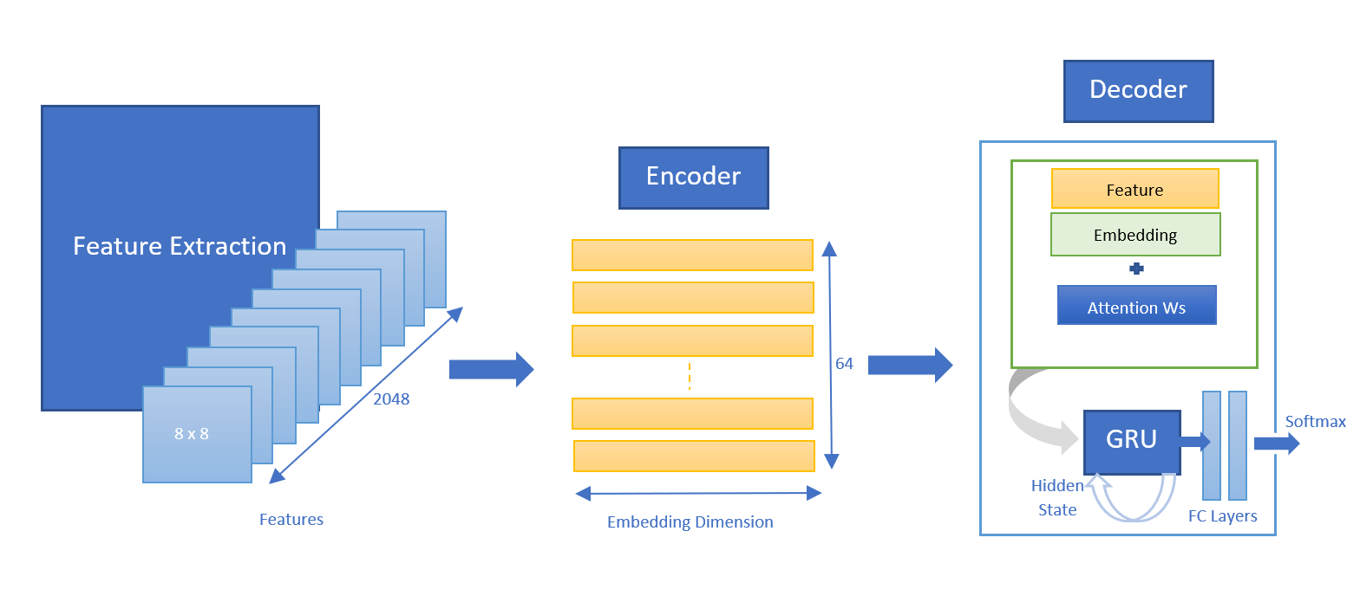
Caption Generation with GRU

Slide 10
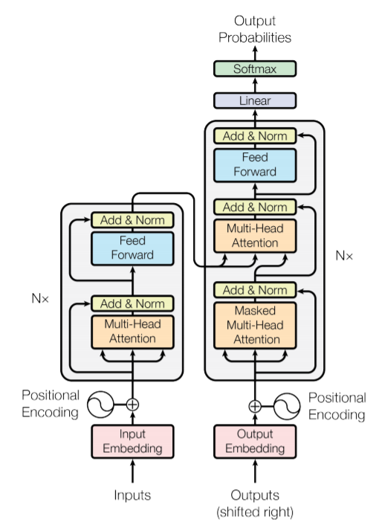
Caption Generation with Transformer

Slide 11
Implementation Specifics
We implemented three models, which can be described as employing,
InceptionV3 feature extraction + RNN with GRUs + Attention
Xception feature extraction + RNN with GRUs + Attention
Xception feature extraction + Transformer Model
We used the Flickr8k dataset for training the models. Each image in it has 5 captions associated with it.
The word embedding size is chosen to be 256.
For the transformer model, the number of layers is limited to N = 4 as opposed to the base model ^{[1]} which has 6 layers.
This model employs 4 parallel attention layers (i.e. the number of attention heads = 4).
Note: Wherever possible, we have tried to ensure the parameters in the original paper are maintained so as to have a fair comparison of the models.
[1] Vaswani, Ashish, et al. "Attention is all you need." Advances in neural information processing systems. 2017.

Slide 12
Evaluation Metric
Several metrics are known for evaluating the quality of the machine-generated text.
We use the BLEU score for assessing the predicted image captions.
BLEU (BiLingual Evaluation Understudy)
“The closer a machine translation is to a professional human translation, the better it is” ^{[1]}
computes similarity between predicted text and reference text using modified precision
essentially a number between 0 and 1; the higher, the better
Additionally, grammatical correctness of the generated description can also be used.
BLEU-n corresponds to the modified precision calculated using n-grams.
We report BLEU-1, BLEU-2, BLEU-3 and BLEU-4 scores for our models.
[1] Papineni, Kishore, et al. "BLEU: a method for automatic evaluation of machine translation." Proceedings of the 40th annual meeting on association for
computational linguistics. Association for Computational Linguistics, 2002.

Slide 13
Results (Comparing BLEU Scores)
Model descriptions:
*: VGG16 + LSTM
#: VGG16 + LSTM + Soft/Hard Attention
^: DenseNet + BLSTM + Game Theoretic Optimization
M1: InceptionV3 + GRU + Soft Attention
M2: Xception + GRU + Soft Attention
M3: Xception + Transformer
MODEL | BLEU-1 | BLEU-2 | BLEU-3 | BLEU-4
Google NIC [2015]* | 0.63 | 0.41 | 0.27 | -
Soft-Attention [2016]# | 0.67 | 0.448 | 0.299 | 0.195
Hard-Attention [2016]# | 0.67 | 0.457 | 0.314 | 0.213
Game Theoretic Search [2019]^ | 0.699 | 0.563 | 0.465 | 0.429
Our Model: M1 | 0.677 | 0.511 | 0.390 | 0.303
Our Model: M2 | 0.689 | 0.523 | 0.404 | 0.319
Our Model: M3 | 0.706 | 0.539 | 0.430 | 0.365
All the BLEU scores, apart from those corresponding to our three models, have been referenced from the respective papers.

Slide 14
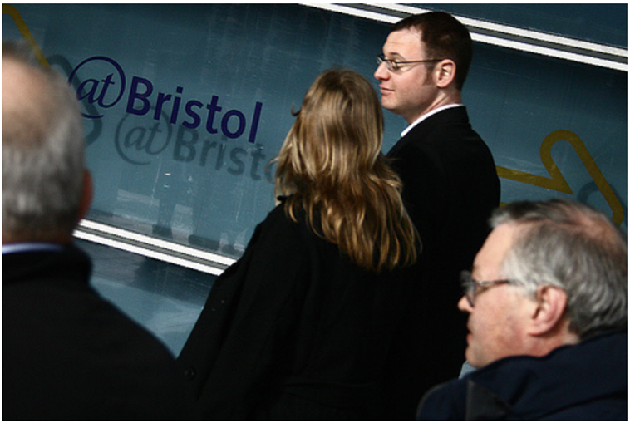
Results (Contd.)
Reference Captions (Ground Truths)
A group of adults are walking.
A man in a black suit looking toward a woman with long hair.
A man wearing glasses and a dark coat looks at something to the left of the picture.
A woman talks to a man while walking in a crowd.
Four people in dark clothes walk in the same direction.
Predicted Captions (BLEU-1 Score in [ ])
M1: A group of men are talk while standing on one busy street while a group of men are walking in a crowd. [0.39]
M2: A woman wearing a blue shirt and a man in a grey <UNK> is walking in a crowd. [0.53]
M3: A group of people walking in a subway station. [0.70]

Slide 15
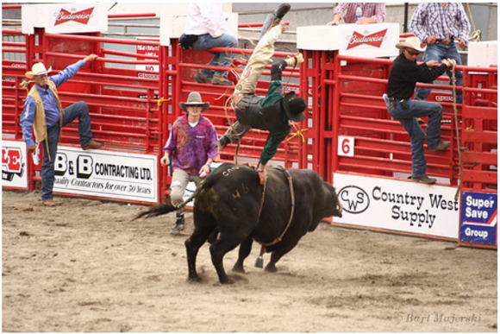
Results (Contd.)
Reference Captions (Ground Truths)
A man in roping a bull in a rodeo while others in cowboy hats watch.
A man is up in the air with one hand on a bull.
A rodeo rider gets tossed up into the air by a black bull as fellow cowboys look on.
Man getting thrown in the air while bull riding.
The man in black is flying off the full in front of a red fence.
Predicted Captions (BLEU-1 Score in [ ])
M1: The girl is flying through the grass. [0.33]
M2: A man is in <UNK> plays an charging bull. [0.50]
M3: A man in black clothes is jumping off a red bull into a tire top. [0.63]

Slide 16
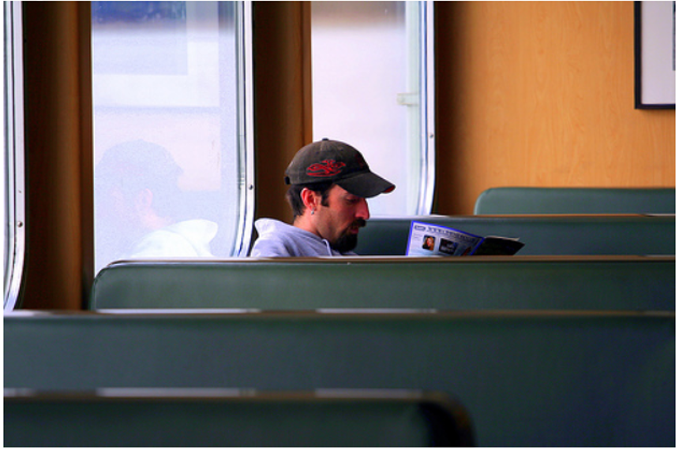
Results (Contd.)
Reference Captions (Ground Truths)
A man in a cap with a goatee leans against the window and reads a magazine.
A man sitting on an empty train.
A man with a black hat and black beard is reading a magazine sitting on a blue bench.
A man with a hat sits in a booth and reads.
The man reading a magazine is sitting in the large room.
Predicted Captions (BLEU-1 Score in [ ])
M1: A man in a cap sitting on a blue bus. [0.82]
M2: A man in a white hat and jeans sitting outside a window and leaning against the window and slide. [0.55]
M3: A man with a goatee wears a black shirt and looking at magazine. [0.56]

Slide 17
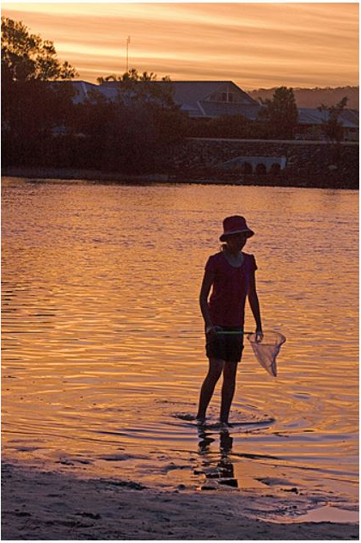
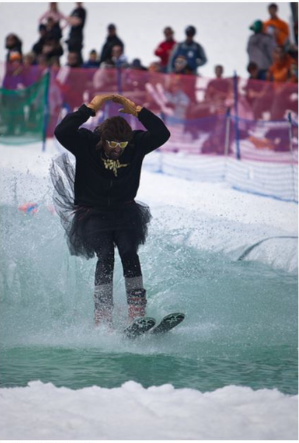
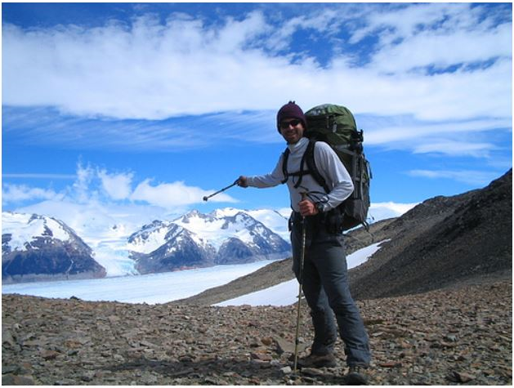
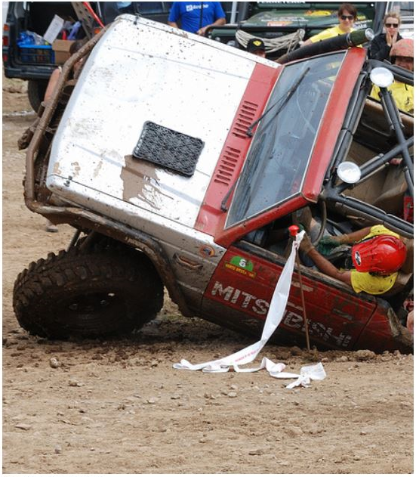
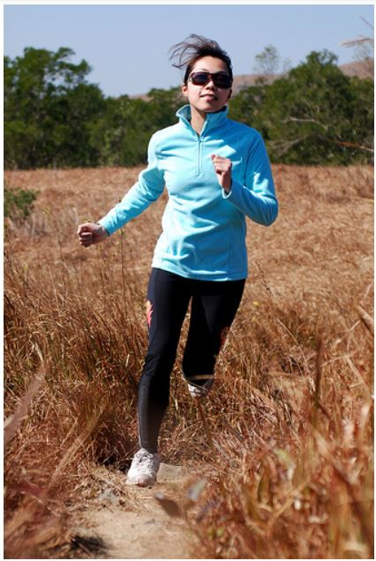
Results (Contd.)
Person wading in the lake with a net.
[0.78]
Figure dressed in a man is flying through the background. [0.80]
A backpacker in the water.
[0.54]
A baby is lying on its side of a white mountaintops.
[0.73]
A woman runs outdoors.
[0.35]

Slide 18
Summary
In this project, we aimed at developing an image captioning model that could generate an accurate description of the content in a given image.
Building upon the original work, we implemented three new models. These were:
InceptionV3 feature extraction + RNN with GRUs + Attention
Xception feature extraction + RNN with GRUs + Attention
Xception feature extraction + Transformer Model
It was observed that replacing the VGG architecture with InceptionV3/Xception architecture and using GRUs instead of LSTM units improved the performance of the model.
The transformer model expectedly provided the best results among our three implementations.

Slide 19
References
Vinyals, Oriol, et al. "Show and tell: A neural image caption generator." Proceedings of the IEEE conference on computer vision and pattern recognition. 2015.
Xu, Kelvin, et al. "Show, attend and tell: Neural image caption generation with visual attention." International conference on machine learning. 2015.
Vaswani, Ashish, et al. "Attention is all you need." Advances in neural information processing systems. 2017.
SR, Sreela, and Sumam Mary Idicula. "Dense Model for Automatic Image Description Generation with Game Theoretic Optimization." Information 10.11 (2019): 354.
Chollet, François. "Xception: Deep learning with depthwise separable convolutions." Proceedings of the IEEE conference on computer vision and pattern recognition. 2017.

